Slide 1
Garbage Collection

Slide 2
Memory Management So Far
●
Some items are preallocated and persist throughout the program:
What are they?
Some are allocated on the runtime stack:
●
●
●
What are they?
●
Some are allocated in the heap:
●
What are they?
How do we manage heap-allocated memory?
●
Notes:
Global variables, virtual function tables, executable code, etc.
Local variables, parameters, temporaries.
Arrays, objects.

Slide 3
Manual Memory Management
Option One: Have programmer handle heap allocation and deallocation
C, C++
Advantages?
Disadvantages?
●
●
Notes:
ADV - Programmer can exercise precise control over memory usage.
DISADV - Programmer has to exercise precise control over memory usage
- forget to free memory (memory leaks), use after free, free twice
Almost always not type safe

Slide 4
Automatic Memory Management
●
Idea: Runtime environment automatically reclaim memory.
What is the garbage?
Advantages?
●
Disadvantages?
Notes:
Garbage - Objects that won't be used again are called
Garbage collection – reclaiming garbage automatically
Adv – programmer doesn’t have to reclaim unused resources
Disadv – programmer can’t reclaim unused resources

Slide 5
Can you Identify Garbage?
●
What is garbage at the indicated points?
int main() {
Object x, y;
x = new Object(); y = new Object();
/* Point A */
x.doSomething(); y.doSomething();
/* Point B */
y = new Object();
/* Point C */
}
Notes:
A – both live
B x is garbage
C both are garbage

Slide 6
Approximating Garbage
In general, undecidable whether an object is garbage.
Need to rely on a conservative approximation.
An object is reachable if it can still be referenced by the program.
Garbage Collector - Detect and reclaim unreachable objects.
Notes:
This does not prevent memory leaks!
Many reachable objects are never used again.
It is very easy to have memory leaks in garbage- collected languages.

Slide 7
GC Assumptions
●
Assume that, at runtime, we can find all existing references in the program.
●
Cannot fabricate a reference to an existing object
Cannot cast pointers to integers or vice-versa.
●
Examples: Java, Python, JavaScript, PHP, etc. Non-examples: C, C++
●
●

Slide 8
GC Types
Incremental vs stop-the-world:
Incremental- run concurrently with program
Stop-the-world - pause program execution to look for garbage
Which is (generally) more precise?
Which would you use in a nuclear reactor control system?
Compacting vs Non-compacting:
compacting - moves objects around in memory.
non-compacting - leaves all objects where they originated.
Which (generally) spends more time garbage collecting? Which (generally) leads to faster program execution?

Slide 9
Major Approaches to GC
Reference Counting
Mark and Sweep
Stop and Copy
Generational

Slide 10
Reference Counting Technique
* Store in each object a reference count (refcount) tracking how many references exist to the object.
* Create a reference to an object: increments refcount.
* Remove a reference to an object: decrements refcount.
* When object refcount==0, unreachable & reclaimed.
Might decrease other objects' refcounts and trigger more reclamations.
●

Slide 11
Reference Counting in Action
class LinkedList { LinkedList next;
}
int main() {
LinkedList LinkedList LinkedList
head = new LinkedList; mid = new LinkedList; tail = new LinkedList;
head.next = mid; mid.next = tail;
mid = tail = null; head.next.next = null; head = null;
}

Slide 12
Reference Counting in Action
class LinkedList { LinkedList next;
}
int main() {
LinkedList LinkedList LinkedList
head = new LinkedList; mid = new LinkedList; tail = new LinkedList;
head.next = mid; mid.next = tail;
mid = tail = null; head.next.next = null; head = null;
}

Slide 13
Reference Counting in Action
class LinkedList { LinkedList next;
}
head
int main() {
LinkedList LinkedList LinkedList
head = new LinkedList; mid = new LinkedList; tail = new LinkedList;
head.next = mid; mid.next = tail;
mid = tail = null;
head.next.next = null;
head = null;
}

Slide 14
Reference Counting in Action
class LinkedList { LinkedList next;
}
0
head
int main() {
LinkedList LinkedList LinkedList
head = new LinkedList; mid = new LinkedList; tail = new LinkedList;
head.next = mid; mid.next = tail;
mid = tail = null;
head.next.next = null;
head = null;
}

Slide 15
Reference Counting in Action
class LinkedList { LinkedList next;
}
0
head
int main() {
LinkedList LinkedList LinkedList
head = new LinkedList; mid = new LinkedList; tail = new LinkedList;
head.next = mid; mid.next = tail;
mid = tail = null;
head.next.next = null;
head = null;
}

Slide 16
Reference Counting in Action
class LinkedList { LinkedList next;
}
1
head
int main() {
LinkedList LinkedList LinkedList
head = new LinkedList; mid = new LinkedList; tail = new LinkedList;
head.next = mid; mid.next = tail;
mid = tail = null;
head.next.next = null;
head = null;
}

Slide 17
Reference Counting in Action
class LinkedList { LinkedList next;
}
1
head
int main() {
LinkedList LinkedList LinkedList
head = new LinkedList; mid = new LinkedList; tail = new LinkedList;
head.next = mid; mid.next = tail;
mid = tail = null;
head.next.next = null;
head = null;
}

Slide 18
Reference Counting in Action
class LinkedList { LinkedList next;
}
1
head
int main() {
LinkedList LinkedList LinkedList
head = new LinkedList; mid = new LinkedList; tail = new LinkedList;
mid
head.next = mid; mid.next = tail;
mid = tail = null;
head.next.next = null;
head = null;
}

Slide 19
Reference Counting in Action
class LinkedList {
} | LinkedList | next;
int | main() { LinkedList | head = new LinkedList;
 | LinkedList LinkedList | mid = new LinkedList; tail = new LinkedList;
head
1
mid
0
head.next = mid; mid.next = tail;
mid = tail = null;
head.next.next = null;
head = null;
}

Slide 20
Reference Counting in Action
class LinkedList {
} | LinkedList | next;
int | main() { LinkedList | head = new LinkedList;
 | LinkedList LinkedList | mid = new LinkedList; tail = new LinkedList;
1
head
mid
0
head.next = mid; mid.next = tail;
mid = tail = null;
head.next.next = null;
head = null;
}

Slide 21
Reference Counting in Action
class LinkedList {
} | LinkedList | next;
int | main() { LinkedList | head = new LinkedList;
 | LinkedList LinkedList | mid = new LinkedList; tail = new LinkedList;
head
1
mid
1
head.next = mid; mid.next = tail;
mid = tail = null;
head.next.next = null;
head = null;
}

Slide 22
Reference Counting in Action
class LinkedList {
} | LinkedList | next;
int | main() { LinkedList | head = new LinkedList;
 | LinkedList LinkedList | mid = new LinkedList; tail = new LinkedList;
head
1
mid
1
head.next = mid; mid.next = tail;
mid = tail = null;
head.next.next = null;
head = null;
}

Slide 23
Reference Counting in Action
class LinkedList {
} | LinkedList | next;
int | main() { LinkedList | head = new LinkedList;
 | LinkedList LinkedList | mid = new LinkedList; tail = new LinkedList;
head
1
mid
tail
1
head.next = mid; mid.next = tail;
mid = tail = null;
head.next.next = null;
head = null;
}

Slide 24
Reference Counting in Action
class LinkedList {
} | LinkedList | next;
int | main() { LinkedList | head = new LinkedList;
 | LinkedList LinkedList | mid = new LinkedList; tail = new LinkedList;
head
1
mid
tail
1
head.next = mid; mid.next = tail;
mid = tail = null;
0
head.next.next = null;
head = null;
}

Slide 25
Reference Counting in Action
class LinkedList {
} | LinkedList | next;
int | main() { LinkedList | head = new LinkedList;
 | LinkedList LinkedList | mid = new LinkedList; tail = new LinkedList;
head
1
mid
tail
1
head.next = mid; mid.next = tail;
mid = tail = null;
0
head.next.next = null;
head = null;
}

Slide 26
Reference Counting in Action
class LinkedList {
} | LinkedList | next;
int | main() { LinkedList | head = new LinkedList;
 | LinkedList LinkedList | mid = new LinkedList; tail = new LinkedList;
head
1
mid
tail
1
head.next = mid;
mid.next = tail;
mid = tail = null;
1
head.next.next = null;
head = null;
}

Slide 27
Reference Counting in Action
class LinkedList {
} | LinkedList | next;
int | main() { LinkedList | head = new LinkedList;
 | LinkedList LinkedList | mid = new LinkedList; tail = new LinkedList;
head
1
mid
tail
2
head.next = mid;
mid.next = tail;
mid = tail = null;
1
head.next.next = null;
head = null;
}

Slide 28
Reference Counting in Action
class LinkedList {
} | LinkedList | next;
int | main() { LinkedList | head = new LinkedList;
 | LinkedList LinkedList | mid = new LinkedList; tail = new LinkedList;
head
1
mid
tail
2
head.next = mid;
mid.next = tail;
mid = tail = null;
2
head.next.next = null;
head = null;
}

Slide 29
Reference Counting in Action
class LinkedList {
} | LinkedList | next;
int | main() { LinkedList | head = new LinkedList;
 | LinkedList LinkedList | mid = new LinkedList; tail = new LinkedList;
head
1
mid
tail
2
head.next = mid; mid.next = tail;
mid = tail = null;
2
head.next.next = null;
head = null;
}

Slide 30
Reference Counting in Action
class LinkedList {
} | LinkedList | next;
int | main() { LinkedList | head = new LinkedList;
 | LinkedList LinkedList | mid = new LinkedList; tail = new LinkedList;
head
1
mid
tail
2
head.next = mid; mid.next = tail;
mid = tail = null;
2
head.next.next = null;
head = null;
}

Slide 31
Reference Counting in Action
class LinkedList {
} | LinkedList | next;
int | main() { LinkedList | head = new LinkedList;
 | LinkedList LinkedList | mid = new LinkedList; tail = new LinkedList;
head
1
mid
tail
2
head.next = mid; mid.next = tail;
mid = tail = null;
1
head.next.next = null;
head = null;
}

Slide 32
Reference Counting in Action
class LinkedList {
} | LinkedList | next;
int | main() { LinkedList | head = new LinkedList;
 | LinkedList LinkedList | mid = new LinkedList; tail = new LinkedList;
head
1
mid
tail
1
head.next = mid; mid.next = tail;
mid = tail = null;
0
head.next.next = null;
head = null;
}

Slide 33
Reference Counting in Action
class LinkedList {
} | LinkedList | next;
int | main() { LinkedList | head = new LinkedList;
 | LinkedList LinkedList | mid = new LinkedList; tail = new LinkedList;
head
1
mid
tail
1
head.next = mid; mid.next = tail;
mid = tail = null;
0
head.next.next = null;
Reclaimed!
head = null;
}

Slide 34
Reference Counting in Action
class LinkedList {
} | LinkedList | next;
int | main() { LinkedList | head = new LinkedList;
 | LinkedList LinkedList | mid = new LinkedList; tail = new LinkedList;
head
1
mid
tail
1
head.next = mid; mid.next = tail;
mid = tail = null;
head.next.next = null;
head = null;
}

Slide 35
Reference Counting in Action
class LinkedList {
} | LinkedList | next;
int | main() { LinkedList | head = new LinkedList;
 | LinkedList LinkedList | mid = new LinkedList; tail = new LinkedList;
head
1
mid
tail
1
head.next = mid; mid.next = tail;
mid = tail = null;
head.next.next = null;
head = null;
}

Slide 36
Reference Counting in Action
class LinkedList {
} | LinkedList | next;
int | main() { LinkedList | head = new LinkedList;
 | LinkedList LinkedList | mid = new LinkedList; tail = new LinkedList;
head
1
mid
tail
1
head.next = mid; mid.next = tail;
mid = tail = null;
head.next.next = null;
head = null;
}

Slide 37
Reference Counting in Action
class LinkedList {
} | LinkedList | next;
int | main() { LinkedList | head = new LinkedList;
 | LinkedList LinkedList | mid = new LinkedList; tail = new LinkedList;
head
0
mid
tail
1
head.next = mid; mid.next = tail;
mid = tail = null;
head.next.next = null;
head = null;
}

Slide 38
Reference Counting in Action
class LinkedList { LinkedList next;
head
0
int main() {
Reclaimed!
 | LinkedList | head = new LinkedList;
 | LinkedList | mid = new LinkedList;
 | LinkedList | tail = new LinkedList;
mid
tail
1
head.next = mid; mid.next = tail;
mid = tail = null;
head.next.next = null;
head = null;
}

Slide 39
Reference Counting in Action
class LinkedList {
} | LinkedList | next;
int | main() { LinkedList | head = new LinkedList;
 | LinkedList LinkedList | mid = new LinkedList; tail = new LinkedList;
head
mid
tail
1
head.next = mid; mid.next = tail;
mid = tail = null;
head.next.next = null;
head = null;
}

Slide 40
Reference Counting in Action
class LinkedList {
} | LinkedList | next;
int | main() { LinkedList | head = new LinkedList;
 | LinkedList LinkedList | mid = new LinkedList; tail = new LinkedList;
head
mid
tail
0
head.next = mid; mid.next = tail;
mid = tail = null;
head.next.next = null;
head = null;
}

Slide 41
Reference Counting in Action
class LinkedList {
} | LinkedList | next;
int | main() { LinkedList | head = new LinkedList;
 | LinkedList LinkedList | mid = new LinkedList; tail = new LinkedList;
head
mid
tail
0
head.next = mid; mid.next = tail;
Reclaimed!
mid = tail = null;
head.next.next = null;
head = null;
}

Slide 42
Reference Counting in Action
class LinkedList { LinkedList next;
}
head
int main() {
LinkedList LinkedList LinkedList
head = new LinkedList; mid = new LinkedList; tail = new LinkedList;
mid
tail
head.next = mid; mid.next = tail;
mid = tail = null;
head.next.next = null;
head = null;
}

Slide 43
Reference Counting: One Major Problem
class LinkedList { LinkedList next;
}
int main() {
LinkedList LinkedList LinkedList
head = new LinkedList; mid = new LinkedList; tail = new LinkedList;
head.next = mid; mid.next = tail; tail.next = head;
head = null; mid = null; tail = null;
}

Slide 44
One Major Problem
class LinkedList { LinkedList next;
head
1
}
int main() {
LinkedList LinkedList LinkedList
mid
head = new LinkedList; mid = new LinkedList; tail = new LinkedList;
tail
2
head.next = mid; mid.next = tail; tail.next = head;
2
head = null; mid = null; tail = null;
}

Slide 45
One Major Problem
class LinkedList { LinkedList next;
head
1
}
int main() {
LinkedList LinkedList LinkedList
mid
head = new LinkedList; mid = new LinkedList; tail = new LinkedList;
tail
2
head.next = mid; mid.next = tail; tail.next = head;
2
head = null; mid = null; tail = null;
}

Slide 46
One Major Problem
class LinkedList { LinkedList next;
head
2
}
int main() {
LinkedList LinkedList LinkedList
mid
head = new LinkedList; mid = new LinkedList; tail = new LinkedList;
tail
2
head.next = mid; mid.next = tail; tail.next = head;
2
head = null; mid = null; tail = null;
}

Slide 47
One Major Problem
class LinkedList { LinkedList next;
head
2
}
int main() {
LinkedList LinkedList LinkedList
mid
head = new LinkedList; mid = new LinkedList; tail = new LinkedList;
tail
2
head.next = mid; mid.next = tail; tail.next = head;
2
head = null; mid = null; tail = null;
}

Slide 48
One Major Problem
class LinkedList { LinkedList next;
head
1
}
int main() {
LinkedList LinkedList LinkedList
mid
head = new LinkedList; mid = new LinkedList; tail = new LinkedList;
tail
2
head.next = mid; mid.next = tail; tail.next = head;
2
head = null; mid = null; tail = null;
}

Slide 49
One Major Problem
class LinkedList { LinkedList next;
head
1
}
int main() {
LinkedList LinkedList LinkedList
mid
head = new LinkedList; mid = new LinkedList; tail = new LinkedList;
tail
2
head.next = mid; mid.next = tail; tail.next = head;
2
head = null; mid = null; tail = null;
}

Slide 50
One Major Problem
class LinkedList { LinkedList next;
head
1
}
int main() {
LinkedList LinkedList LinkedList
mid
head = new LinkedList; mid = new LinkedList; tail = new LinkedList;
tail
2
head.next = mid; mid.next = tail; tail.next = head;
2
head = null; mid = null; tail = null;
}

Slide 51
One Major Problem
class LinkedList { LinkedList next;
head
1
}
int main() {
LinkedList LinkedList LinkedList
mid
head = new LinkedList; mid = new LinkedList; tail = new LinkedList;
tail
1
head.next = mid; mid.next = tail; tail.next = head;
2
head = null; mid = null; tail = null;
}

Slide 52
One Major Problem
class LinkedList { LinkedList next;
head
1
}
int main() {
LinkedList LinkedList LinkedList
mid
head = new LinkedList; mid = new LinkedList; tail = new LinkedList;
tail
1
head.next = mid; mid.next = tail; tail.next = head;
2
head = null; mid = null; tail = null;
}

Slide 53
One Major Problem
class LinkedList { LinkedList next;
head
1
}
int main() {
LinkedList LinkedList LinkedList
mid
head = new LinkedList; mid = new LinkedList; tail = new LinkedList;
tail
1
head.next = mid; mid.next = tail; tail.next = head;
2
head = null; mid = null; tail = null;
}

Slide 54
One Major Problem
class LinkedList { LinkedList next;
head
1
}
int main() {
LinkedList LinkedList LinkedList
mid
head = new LinkedList; mid = new LinkedList; tail = new LinkedList;
tail
1
head.next = mid; mid.next = tail; tail.next = head;
1
head = null; mid = null; tail = null;
}

Slide 55
One Major Problem
class LinkedList { LinkedList next;
head
1
}
int main() {
LinkedList LinkedList LinkedList
mid
head = new LinkedList; mid = new LinkedList; tail = new LinkedList;
tail
1
head.next = mid; mid.next = tail; tail.next = head;
1
head = null; mid = null; tail = null;
}

Slide 56
Does not Reclaim Reference Cycles
A reference cycle is a set of objects that cyclically refer to one another.
Because all the objects are referenced, all have nonzero refcounts and are never reclaimed.
Issue: Refcount tracks number of references, not number of reachable references.
Major problems in languages/systems that use reference counting:
●
●
●
●
●
e.g. Perl, Firefox 2.

Slide 57
Analysis of Reference Counting
Advantages:
Simple to implement.
Can be implemented as a library on top of explicit memory management.
●
●
●
●
Disadvantages:
Fails to reclaim all unreachable objects.
Can be slow if a large collection is initiated. Noticeably slows down assignments.
●
●
●

Slide 58
Mark-and-Sweep

Slide 59
Mark-and-Sweep Technique
Given knowledge of what's immediately accessible, find everything reachable in the program.
Root Set - set of memory locations in the program that are known immediately to be reachable.
●
●
●
Any objects reachable from the root set are reachable.
Any objects not reachable from the root set are not reachable.
-> Graph search starting at the root set
●

Slide 60
Mark-and-Sweep: The Algorithm
●
Marking phase: Find reachable objects.
Add the root set to a worklist. While the worklist isn't empty:
●
●
Remove an object from the worklist.
If not marked, mark and add to the worklist all objects reachable from that object.
–
–
●
Sweeping phase: Reclaim free memory.
●
For each allocated object:
–
–
If that object isn't marked, reclaim its memory.
If the object is marked, unmark it (so on the next mark-and- sweep iteration we have to mark it again).

Slide 61
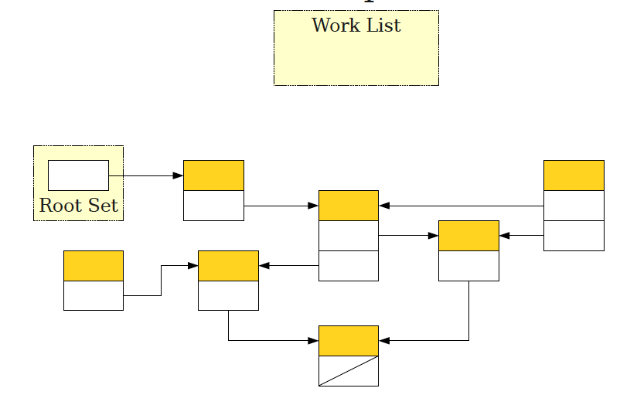
Marking Phase

Slide 62
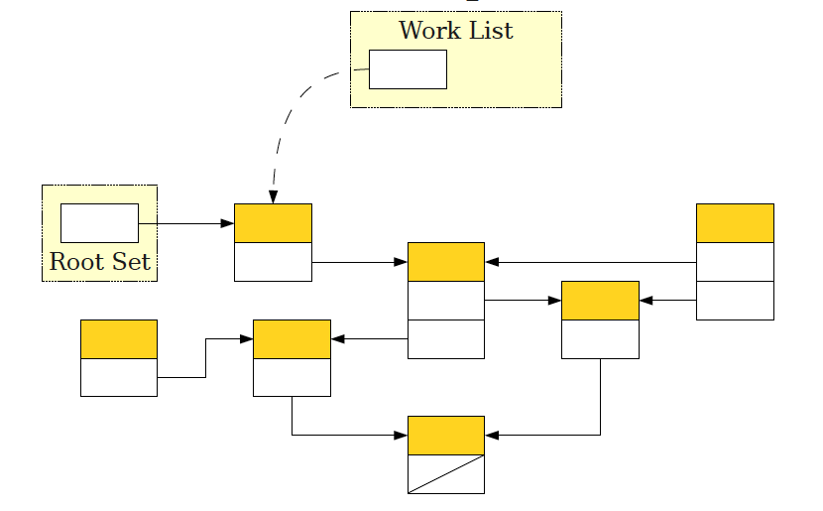
Marking Phase

Slide 63
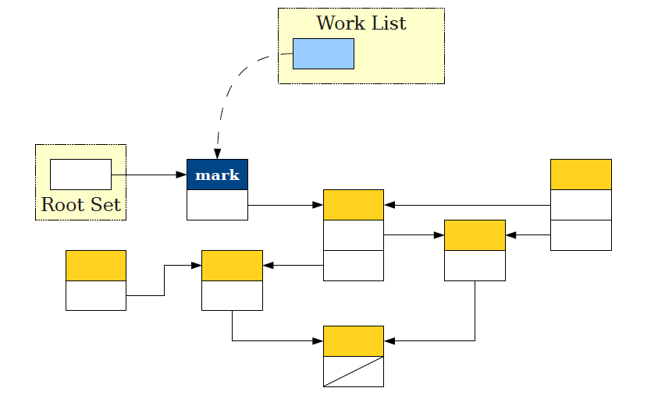
Marking Phase

Slide 64
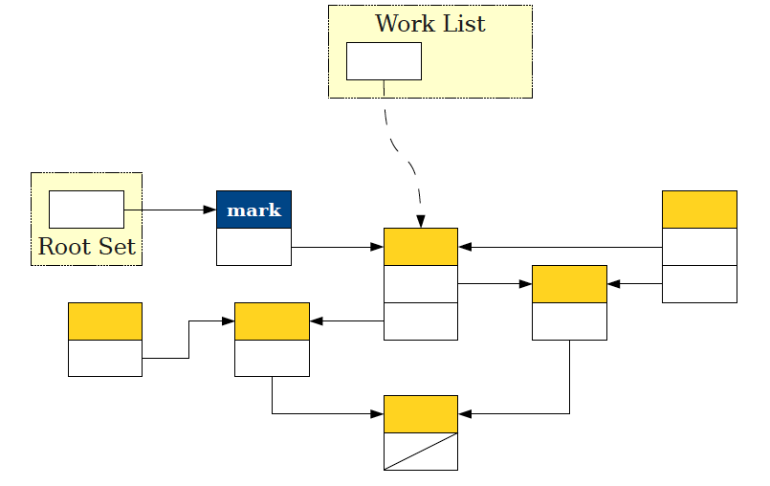
Marking Phase

Slide 65
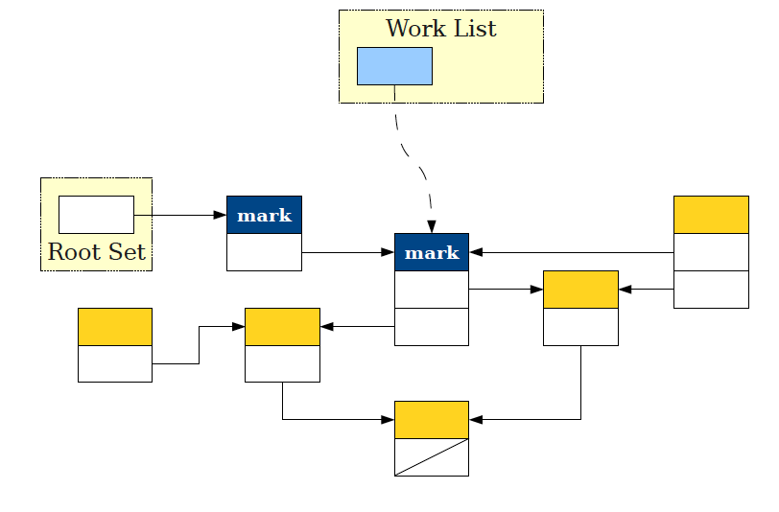
Marking Phase

Slide 66
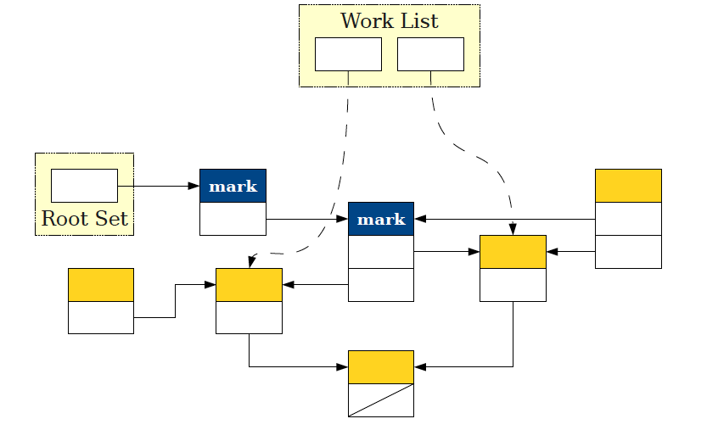
Marking Phase

Slide 67
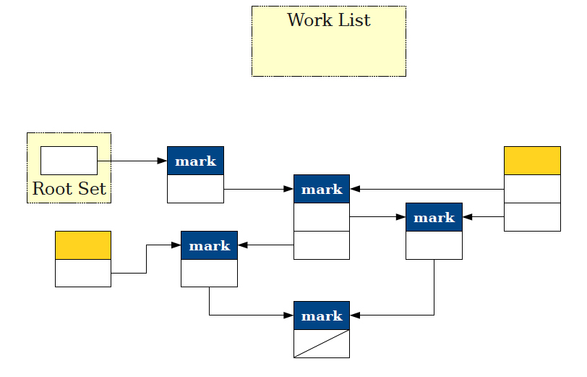
At End of Marking Phase

Slide 68
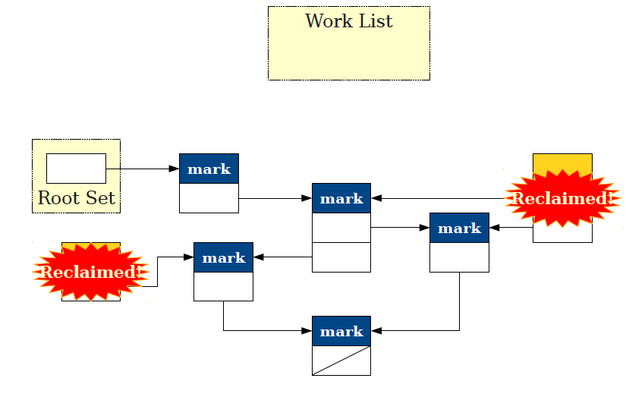
Sweep Phase: Sweep Entire Heap

Slide 69
Mark-and-Sweep Problems
Sweep phase visits all objects to free them or clear marks.
Amount of space for worklist could potentially be as large as all of memory.
Can't preallocate this space.

Slide 70
Implementation Details
During a mark-and-sweep collection, every allocated block must be in exactly one of four states:
Marked: This object is known to be reachable.
Enqueued: This object is in the worklist.
Unknown: This object has not yet been seen.
Deallocated: This object has already been freed.
●
Augment every allocated block with two bits to encode which of these four states the object is in.
Maintain doubly-linked lists of all the objects in each of these states.

Slide 71
More Efficient: Baker's Algorithm
Move entire Root set to the enqueued list.
While enqueued list is not empty:
Move first object from enqueued list to marked list.
For each unknown object referenced, add it to the
enqueued list.
At this point, everything reachable is in marked and everything unreachable is in unknown.
Concatenate unknown and deallocated lists
Deallocates all garbage in O(1).
Move everything from marked list to unknown list.
Can be done in O(1).
Indicates objects again must be proven reachable on next scan.

Slide 72
One Last Detail
If we're already out of memory, how do we build these linked lists?
Idea: Since every object can only be in one linked list, embed the next and previous pointers into each
●
●
allocated block.
 | State
 | Next
 | Previous
 | Vtable *
 | Object Fields
 | State
 | Next
 | Previous
 | Vtable *
 | Object Fields
 | State
 | Next
 | Previous
 | Vtable *
 | Object Fields

Slide 73
Analysis of Mark-and-Sweep
●
Advantages:
●
Precisely finds exactly the reachable objects.
Using Baker's algorithm, runs in time proportional to the number of reachable objects.
●
●
Disadvantages:
●
Stop-the-world may introduce huge pause times.
Linked list / state information in each allocated block uses lots of memory per object.
●

Slide 74
Stop-and-Copy

Slide 75
Improving Performance
●
There are many ways to improve a program's performance, some of which can be improved by a good garbage collector:
Increasing locality.
●
●
Memory caches often designed to hold adjacent memory locations.
Placing objects consecutively in memory can improve performance by reducing cache misses.
●
●
Increasing allocation speed.
●
Many languages (Java, Haskell, Python, etc.) allocate objects frequently.
Speeding up object allocation can speed up program execution.
●

Slide 76
Increasing Locality
●
Idea: During garbage collection, move all objects in memory so they are adjacent to one another.
●
-> compaction.
●
Ideally, move objects that reference one another into adjacent memory locations.
Garbage collector must update all pointers in all objects to refer to the new object locations.
●

Slide 77
Increasing Allocation Speed
Typically implementations of malloc and free use
free lists, linked lists of free memory blocks.
Allocating an object requires following these pointers until a suitable object is found.
●
●
Usually fast, but at least 10 – 20 assembly instructions.
Contrast with stack allocation – just one assembly instruction!
Can we somehow get the performance speed of the stack for dynamic allocation?
●
●
●

Slide 78
The Stop-and-Copy Collector
All of memory

Slide 79
The Stop-and-Copy Collector
New Space
Old Space

Slide 80
The Stop-and-Copy Collector
Free Space

Slide 81
The Stop-and-Copy Collector
Free Space

Slide 82
The Stop-and-Copy Collector
Free Space

Slide 83
The Stop-and-Copy Collector
Free Space

Slide 84
The Stop-and-Copy Collector
Free Space

Slide 85
The Stop-and-Copy Collector
Free Space

Slide 86
The Stop-and-Copy Collector
Free Space

Slide 87
The Stop-and-Copy Collector
Free Space

Slide 88
The Stop-and-Copy Collector
Free Space

Slide 89
The Stop-and-Copy Collector
Free Space

Slide 90
The Stop-and-Copy Collector
Free Space

Slide 91
The Stop-and-Copy Collector
Free Space
Out of space!

Slide 92
The Stop-and-Copy Collector
Root Set
Free Space

Slide 93
The Stop-and-Copy Collector
Root Set
Free Space

Slide 94
The Stop-and-Copy Collector
Root Set
Free Space

Slide 95
The Stop-and-Copy Collector
Root Set
Free Space

Slide 96
The Stop-and-Copy Collector
Root Set
Free Space

Slide 97
The Stop-and-Copy Collector
Free Space
Root Set

Slide 98
The Stop-and-Copy Collector
Free Space
Root Set

Slide 99
The Stop-and-Copy Collector
Free Space
Root Set

Slide 100
The Stop-and-Copy Collector
Free Space
Root Set

Slide 101
The Stop-and-Copy Collector
Free Space

Slide 102
The Stop-and-Copy Collector
Free Space

Slide 103
The Stop-and-Copy Collector
Free Space

Slide 104
The Stop-and-Copy Collector
Free Space

Slide 105
The Stop-and-Copy Collector
Root Set
Free Space

Slide 106
The Stop-and-Copy Collector
Root Set
Free Space

Slide 107
The Stop-and-Copy Collector
Root Set
Free Space

Slide 108
The Stop-and-Copy Collector
Root Set
Free Space

Slide 109
The Stop-and-Copy Collector
Free Space
Root Set

Slide 110
The Stop-and-Copy Collector
Free Space
Root Set

Slide 111
The Stop-and-Copy Collector
Free Space
Root Set

Slide 112
The Stop-and-Copy Collector
Free Space
Root Set

Slide 113
The Stop-and-Copy Collector
Free Space

Slide 114
Stop-and-Copy in Detail
Partition memory into two regions: old space and new space.
Keep track of the next free address in the new space.
To allocate n bytes of memory:
●
If n bytes space exist at the free space pointer, use those bytes and advance the pointer.
Otherwise, do a copy step.
●
●
To execute a copy step:
●
For each object in the root set:
–
–
Copy that object to the start of the old space.
Recursively copy all objects reachable from that object.
●
Adjust the pointers in the old space and root set to point to new locations.
Exchange the roles of the old and new spaces.
●

Slide 115
Implementing Stop and Copy
Only tricky part about stop-and-copy is adjusting pointers in the copied objects correctly.
Idea: Have each object contain a extra space for a
forwarding pointer.
To clone an object:
●
●
●
●
First, do a complete bitwise copy of the object.
–
All pointers still point to their original locations.
Next, set the forwarding pointer of the original object to point to the new object.
Finally, after cloning each object, for each pointer:
●
●
●
Follow the pointer to the object it references.
Replace the pointer with the pointee's forwarding pointer.
●

Slide 116
Forwarding Pointers
Root Set

Slide 117
Forwarding Pointers
Root Set

Slide 118
Forwarding Pointers
Root Set

Slide 119
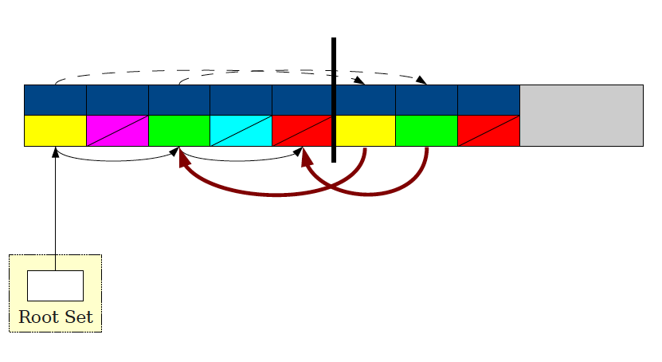
Forwarding Pointers

Slide 120
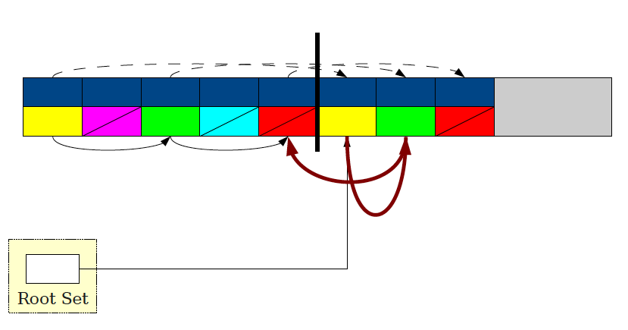
Forwarding Pointers

Slide 121
Forwarding Pointers

Slide 122
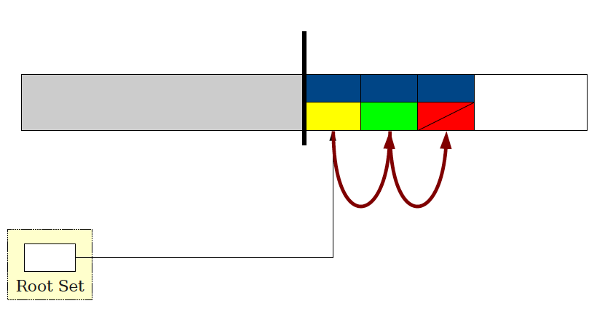
Forwarding Pointers

Slide 123
Analysis of Stop-and-Copy
Advantages:
Implementation simplicity (compared to mark-and- sweep).
Fast memory allocation; using OS-level tricks, can allocate in a single assembly instruction.
Excellent locality; depth-first ordering of copied objects places similar objects near each other.
●
●
●
●
●
Disadvantages:
●
Requires half of memory to be free at all times.
Collection time proportional to number of bytes used by objects.
●

Slide 124
Hybrid Approaches

Slide 125
The Best of All Worlds
The best garbage collectors in use today are based on a combination of smaller garbage collectors.
Each garbage collector is targeted to reclaim specific types of garbage.
Usually has some final “fallback” garbage collector to handle everything else.
●
●
●

Slide 126
Objects Die Young
The Motto of GC: Objects Die Young.
Most objects have very short lifetimes.
●
Objects allocated locally in a function.
Temporary objects used to construct larger objects.
●
Optimize GC to reclaim young objects rapidly while spending less time on older objects.

Slide 127
Generational GC
Partition memory into several “generations.”
Objects always allocated in the first generation.
When the first generation fills up, garbage collect it.
●
Runs quickly; collects only a small region of memory.
●
Move objects that survive in the first generation long enough into the next generation.
When no space can be found, run a full (slower) garbage collection on all of memory.
●

Slide 128
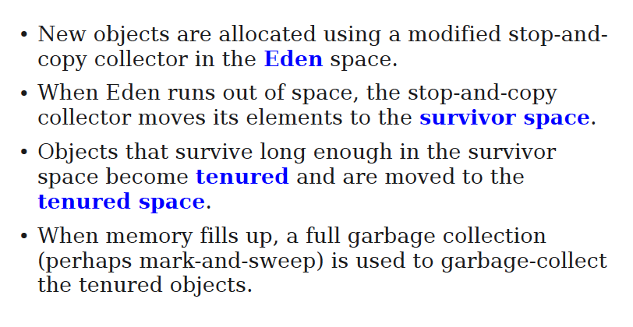
Generational GC Technique

Slide 129
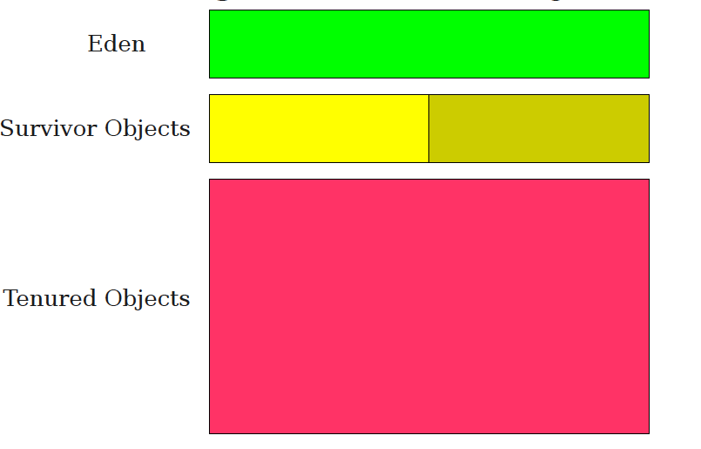
Generational GC

Slide 130
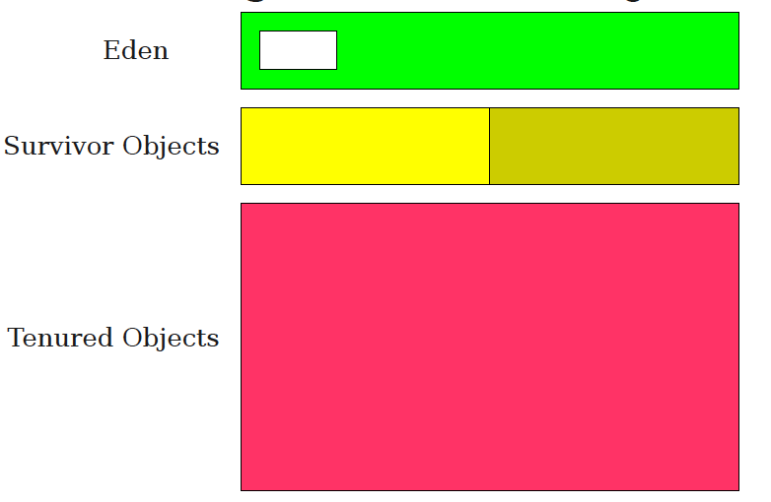
Allocating in Eden

Slide 131
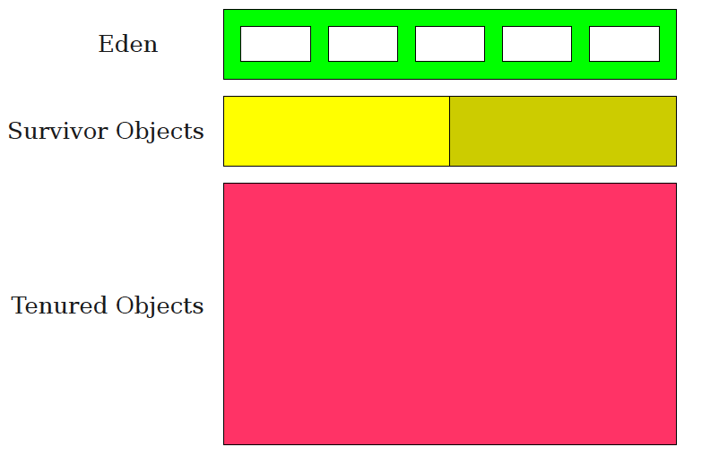
Allocating in Eden

Slide 132
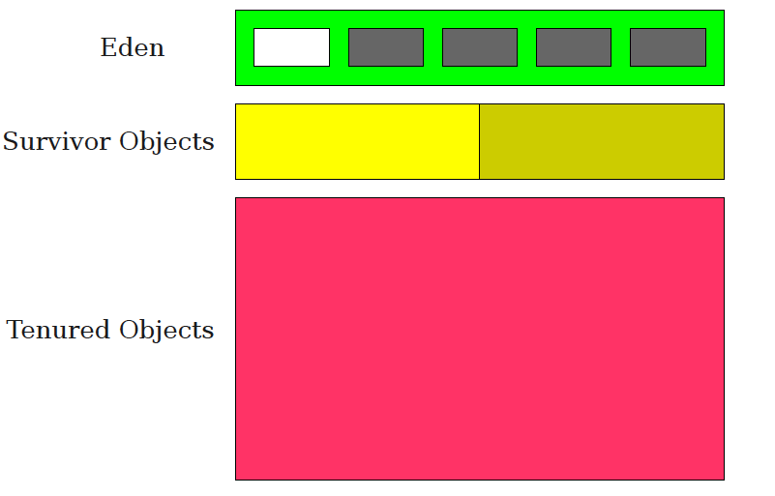
Some are short lived, others not

Slide 133
Stop & Copy moves survivors

Slide 134
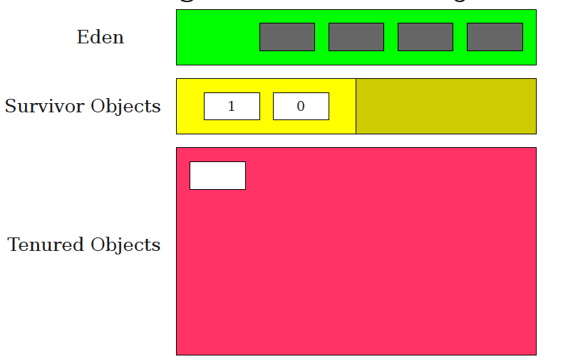
Some survive enough to be tenured

Slide 135
Checkpoint on GC
Why GC?
What are the main types of GC ?
For each main GC:
How does it work?
What is the main intuition behind it?
Advantages?
Disadvantages?
Reference Counting
Mark and Sweep
Stop and Copy
Generational

